Slide 1
CSC589 Introduction to Computer Vision Lecture 6
Image gradients
Bei Xiao
September 24th, 2017

Slide 2
Last lecture
Linear Algebra
Matrix computation in Python

Slide 3
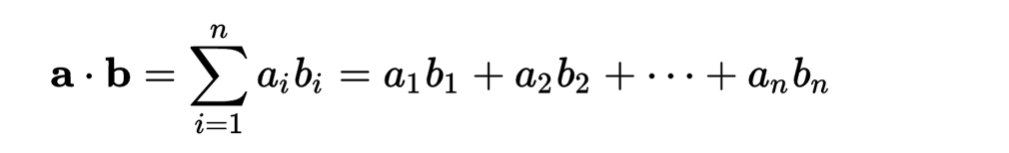
Algebraic definition of dot product

Slide 4
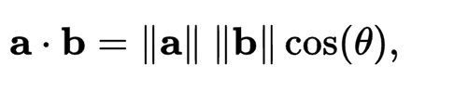
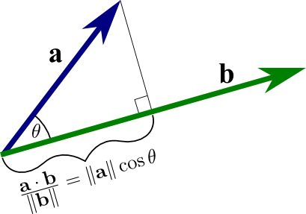
Geometric definition of dot product: projection of one over another
http://mathinsight.org/dot_product
Notes:
How much of a is pointing to the same direction as b.

Slide 5
Today’s lecture
Edges and image gradients
Quiz
Image De-noising
Median Filter
Project 1 will be out on Thursday.

Slide 6
Reading
Chapter 3.2. Page 99-105.

Slide 7

Characterizing edges
An edge is a place of rapid change in the image intensity function
intensity function (along horizontal scanline)
image
first derivative
edges correspond to extrema of derivative
Source: L. Lazebnik

Slide 8
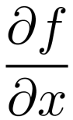
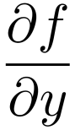
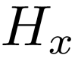
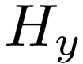
Image derivatives
How can we differentiate a digital image F[x,y]?
Option 1: reconstruct a continuous image, f, then compute the derivative
Option 2: take discrete derivative (finite difference)
How would you implement this as a linear filter?
1 | -1
 | -1
 | 1
:
:
Source: S. Seitz

Slide 9

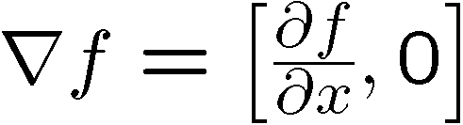
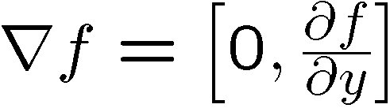
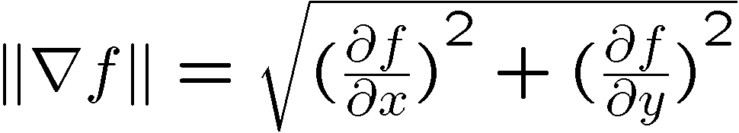
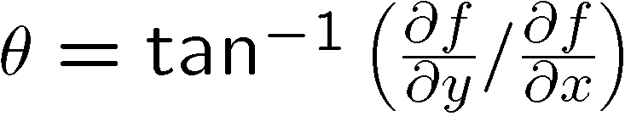
Image gradient
The gradient of an image:
The gradient points in the direction of most rapid increase in intensity
The edge strength is given by the gradient magnitude:
The gradient direction is given by:
how does this relate to the direction of the edge?
Source: Steve Seitz
Notes:
give definition of partial derivative: lim h->0 [f(x+h,y) – f(x,y)]/h

Slide 10
Image gradient
Source: L. Lazebnik

Slide 11
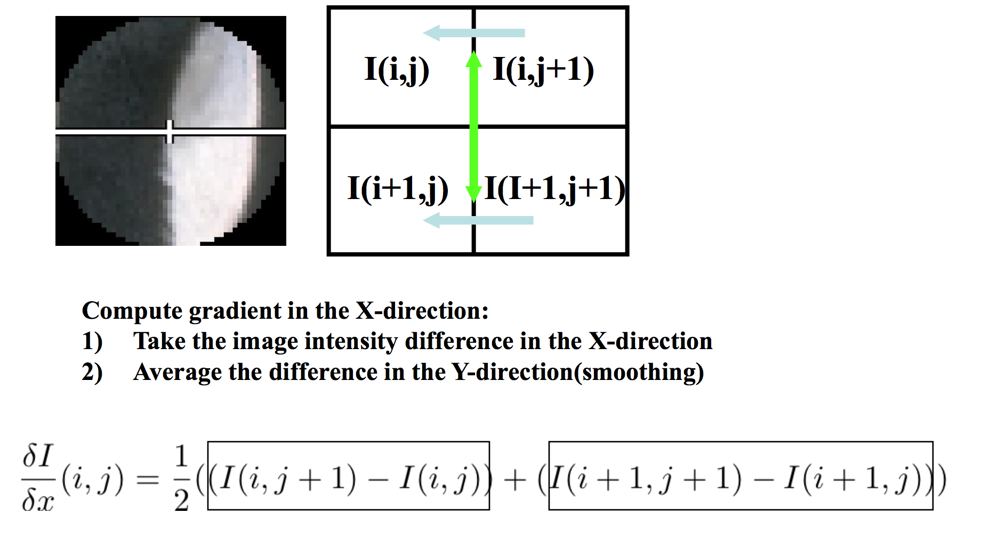
Compute gradient: first order derivatives
Slide source: Jianbo Shi

Slide 12
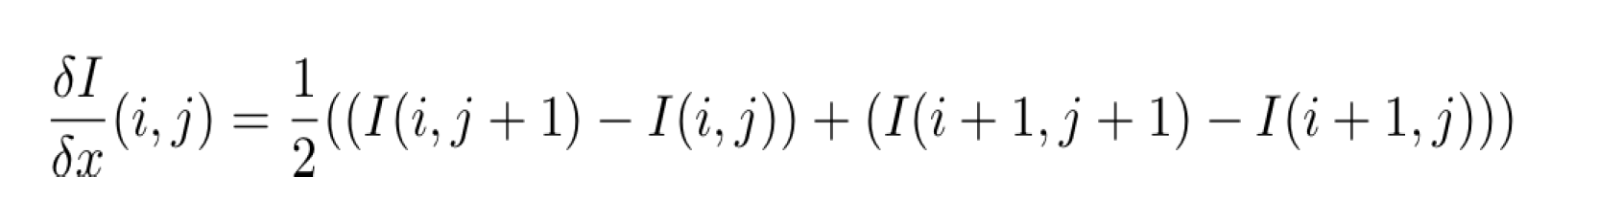
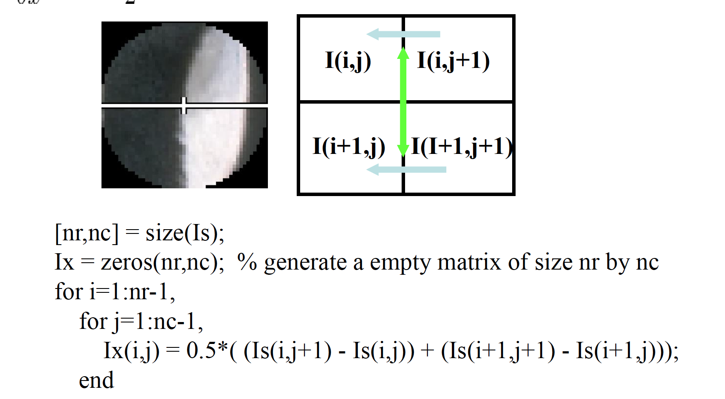
Compute gradient: first order derivatives
Slide source: Jianbo Shi

Slide 13
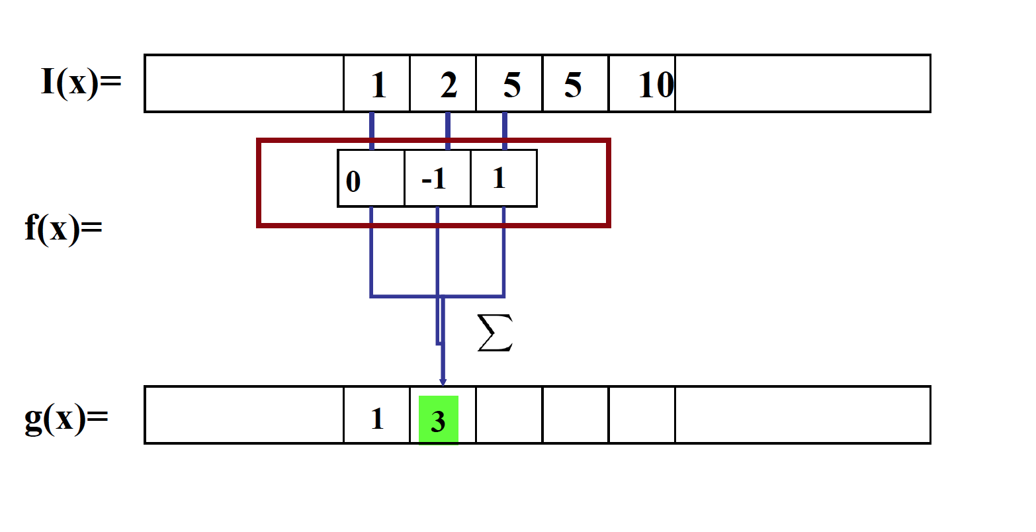
Compute gradient as convolution operation!

Slide 14
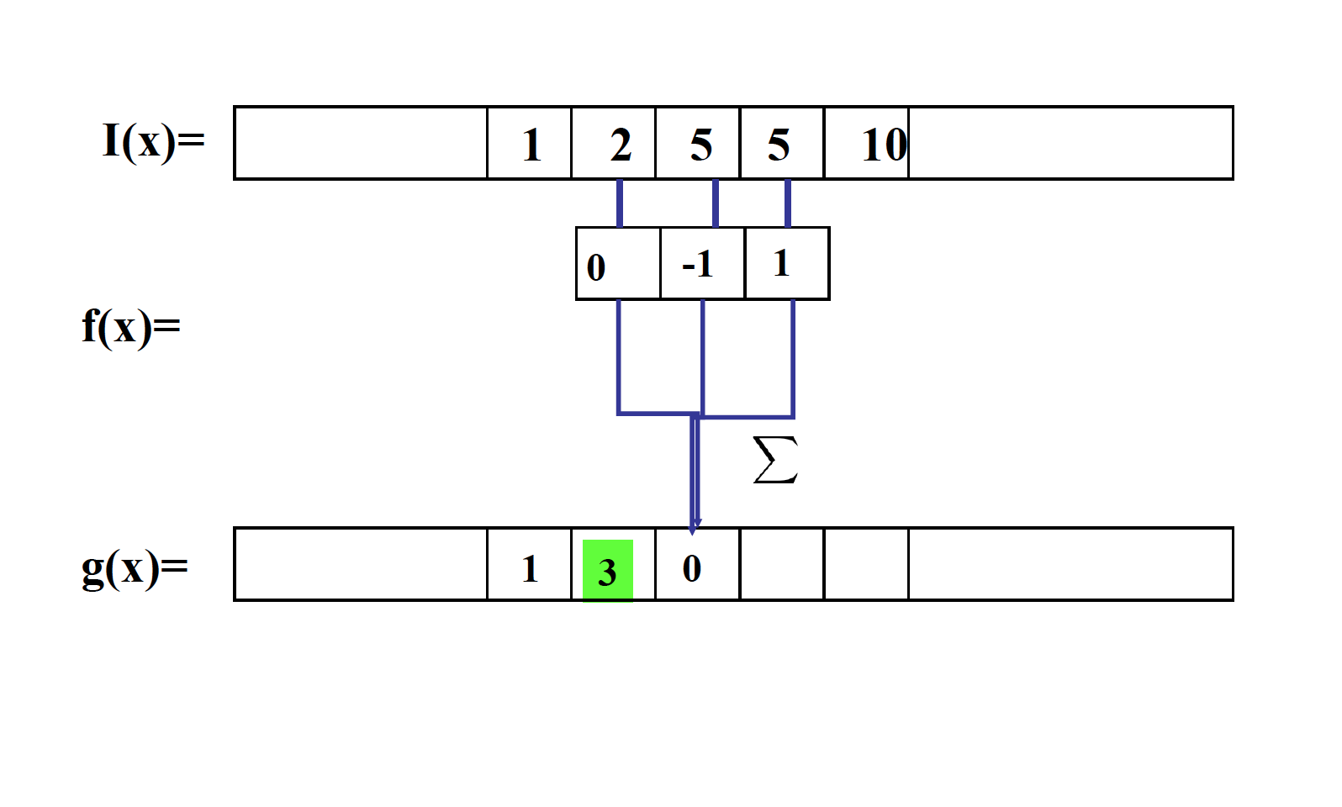
Compute gradient as convolution operation!

Slide 15
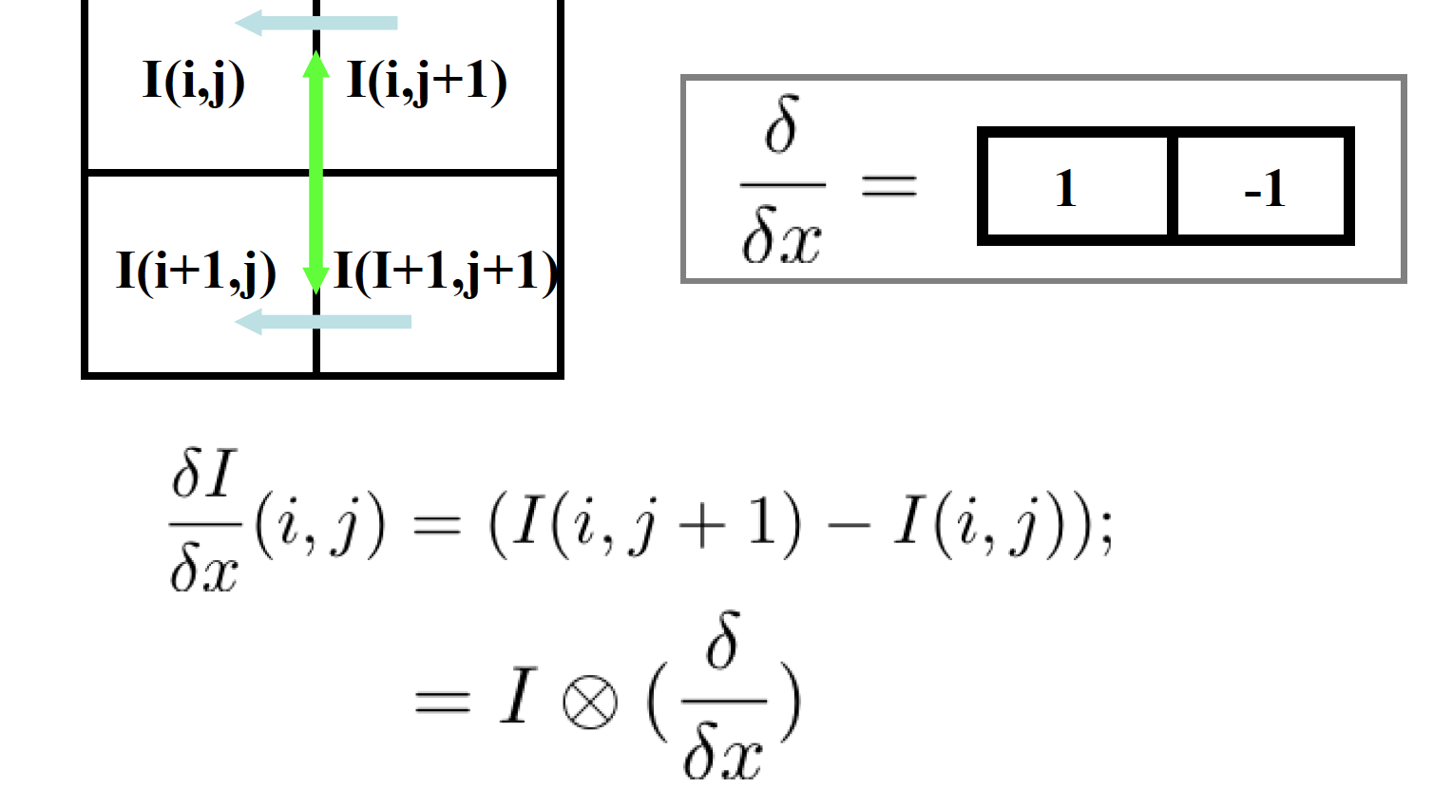
Compute gradient: first order derivatives

Slide 16
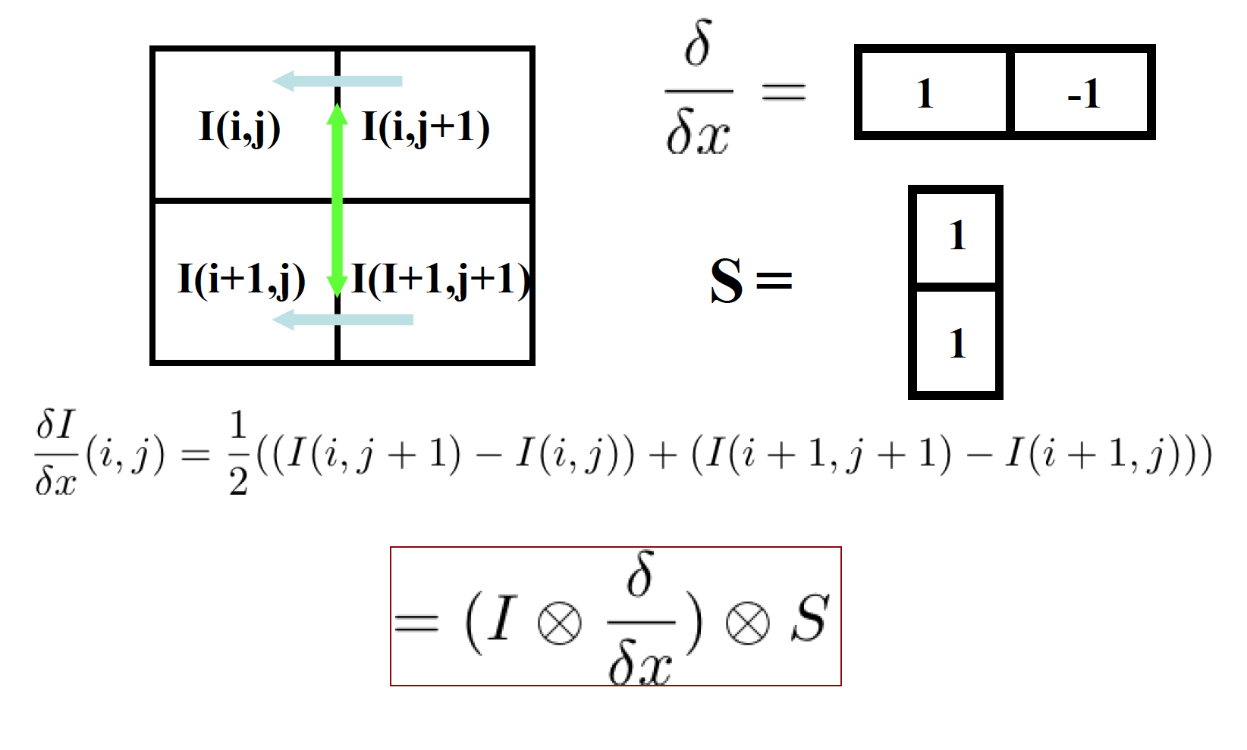
Compute gradient: first order derivatives

Slide 17
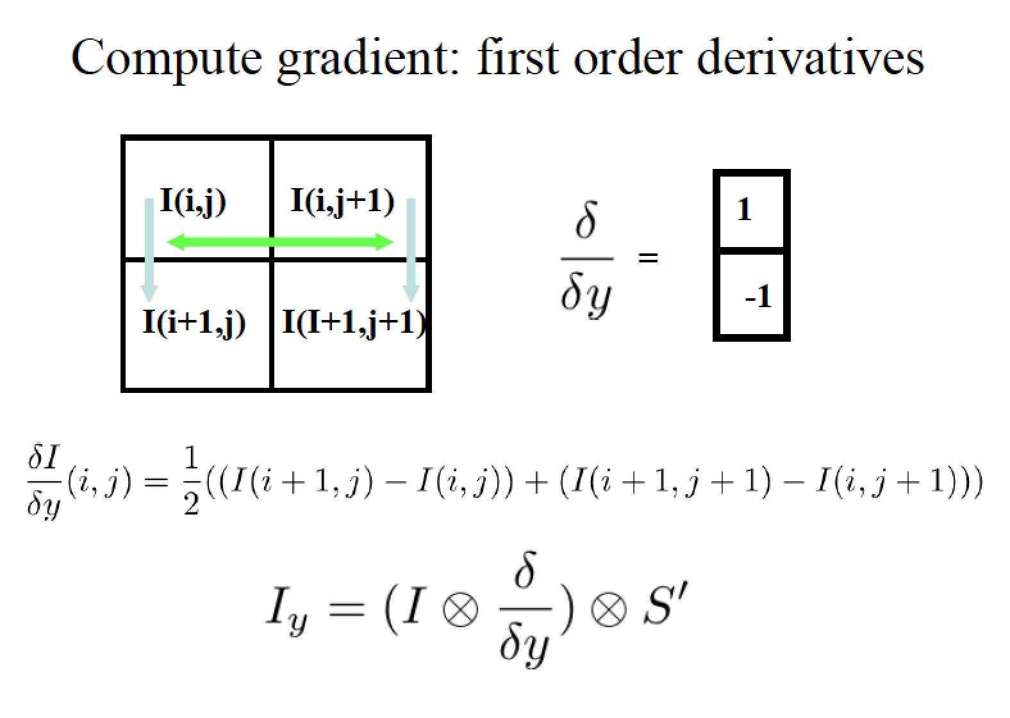

Slide 18

Example

Slide 19
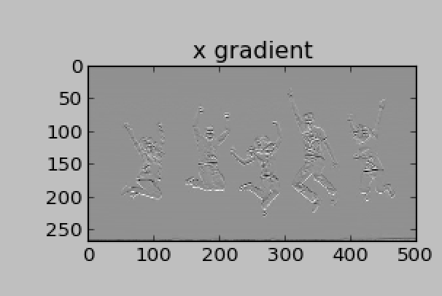
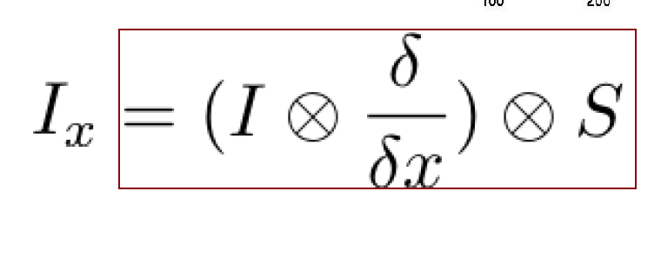
Exercise in Python
s1 = np.array([1,1])
dx = np.array([1,-1])
dy = np.array([1,-1])
x = ndimage.convolve1d(l,dx,axis= 0)
gx_I = ndimage.convolve(x,s)

Slide 20
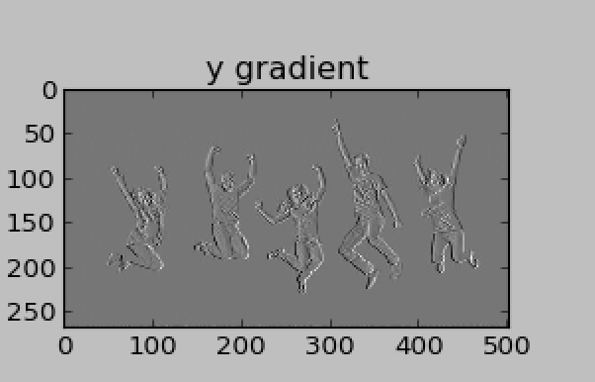
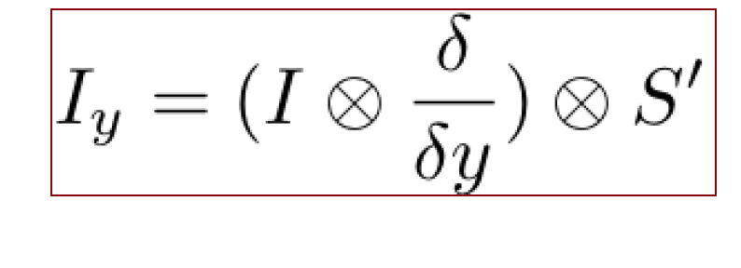
Usage in Python
s1 = np.array([1,1])
dx = np.array([1,-1])
dy = np.array([1,-1])
y = ndimage.convolve1d(l,dx,axis= 1)
gy_I = ndimage.convolve(y,s)
Or : gx_I,gy_I = np.gradient(l)[:2]

Slide 21

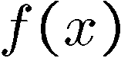
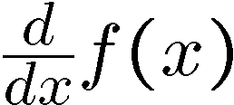
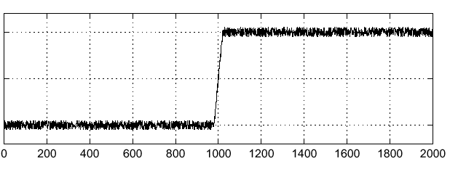
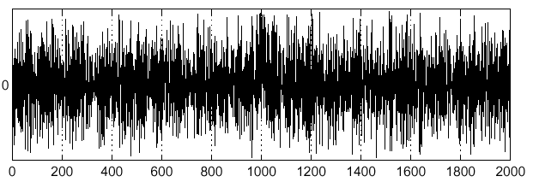
Effects of noise
Noisy input image
Where is the edge?
Source: S. Seitz
Notes:
How to fix?

Slide 22
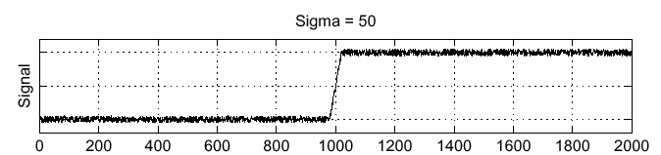
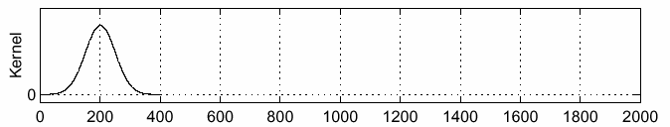
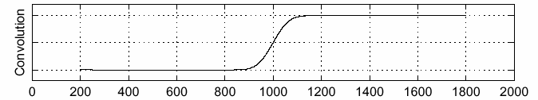
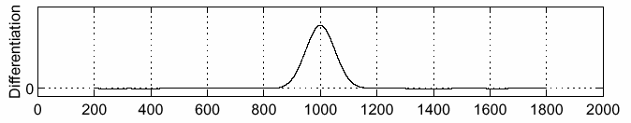
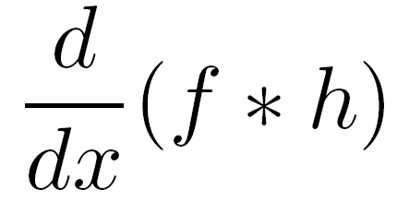
Solution: smooth first
f
h
f * h
To find edges, look for peaks in
Source: S. Seitz

Slide 23
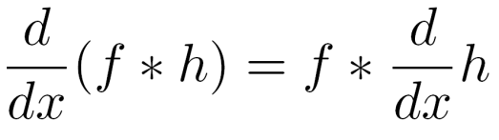
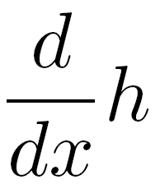
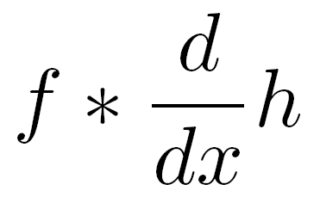
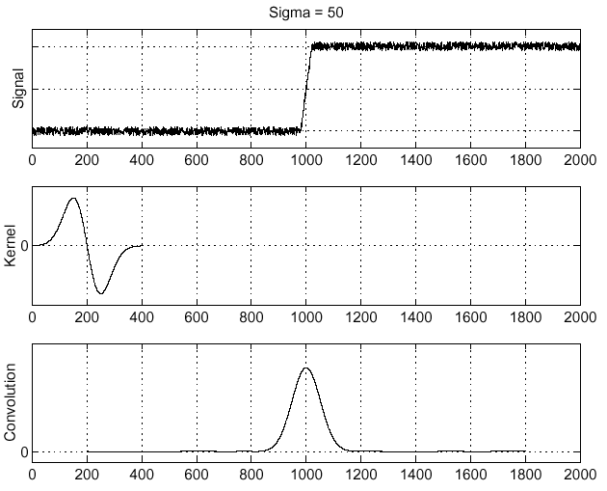
Associative property of convolution
Differentiation is convolution, and convolution is associative:
This saves us one operation:
f
Source: S. Seitz

Slide 24
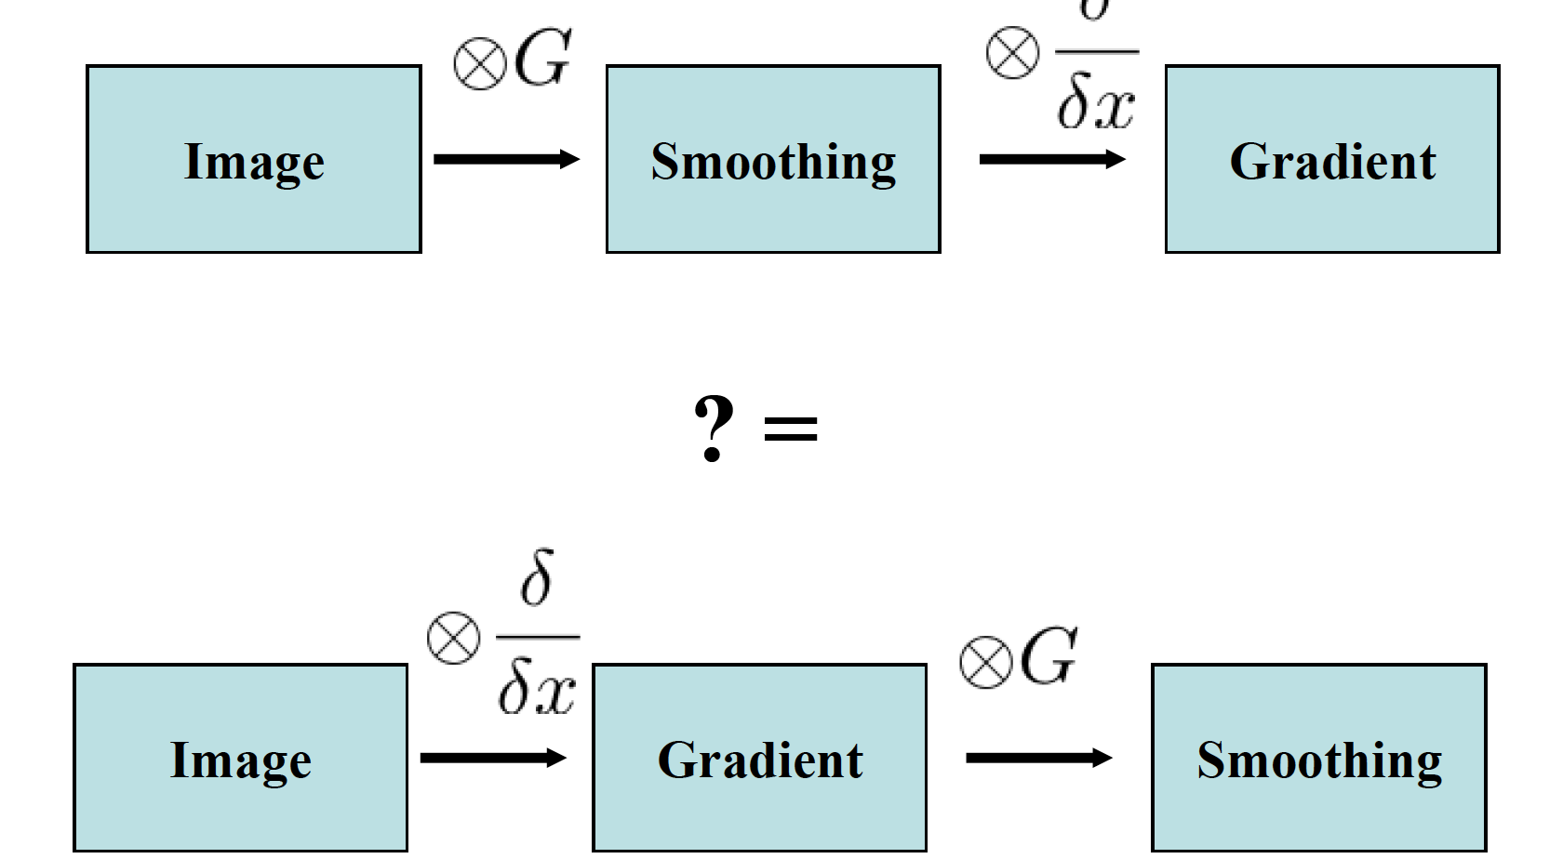
We can switch the order of smoothing and gradient

Slide 25
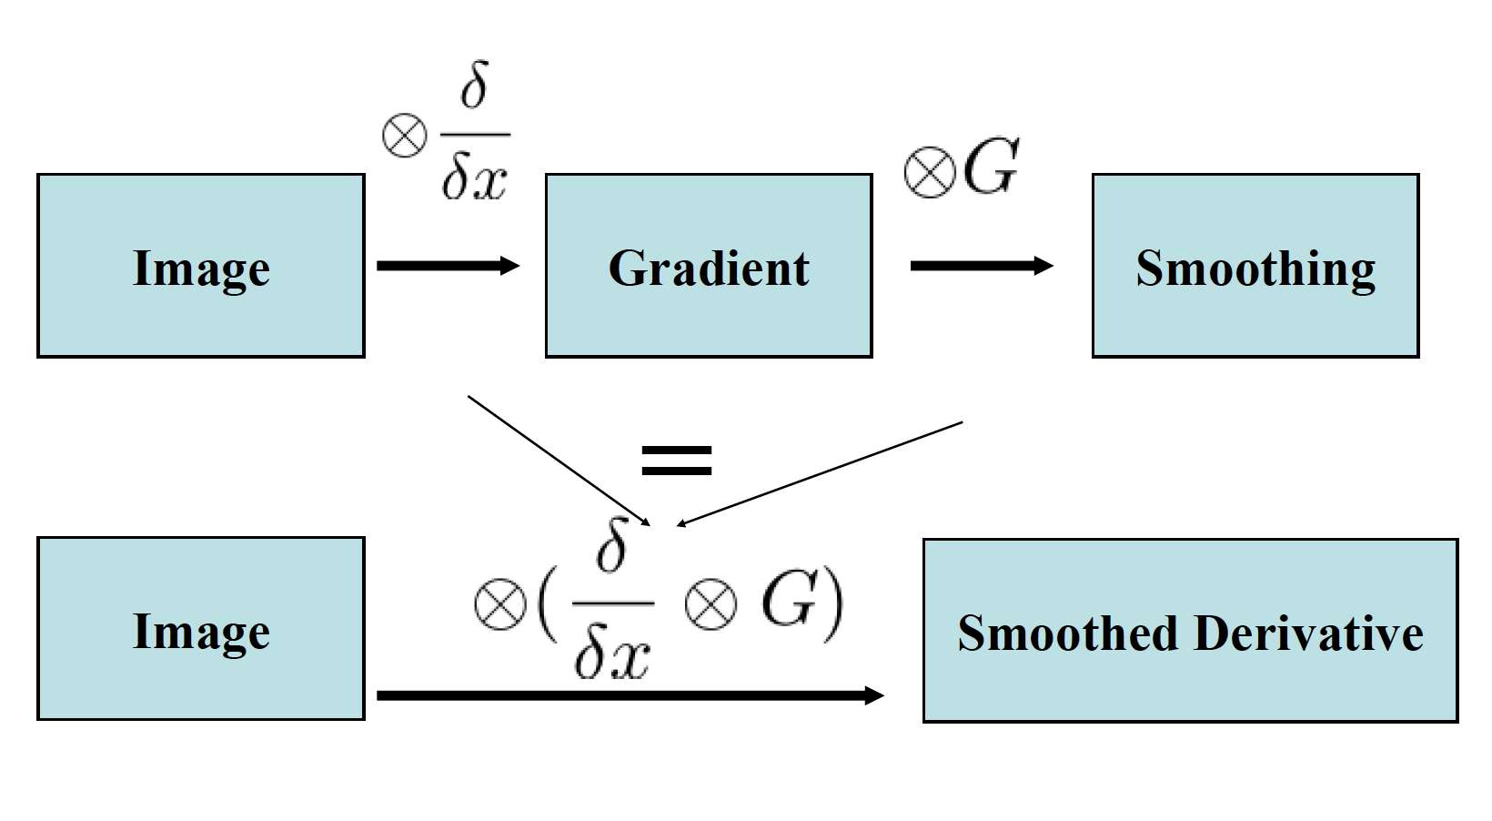
We can simplify even more

Slide 26
We can simplify even more

Slide 27
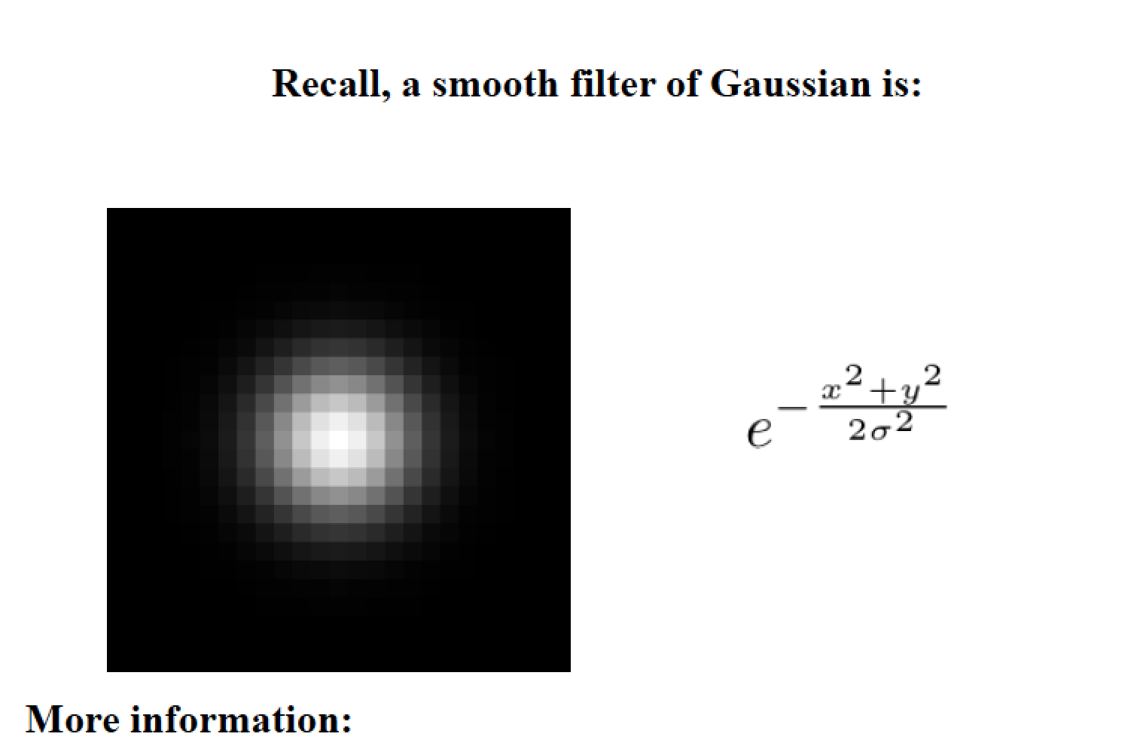

Slide 28
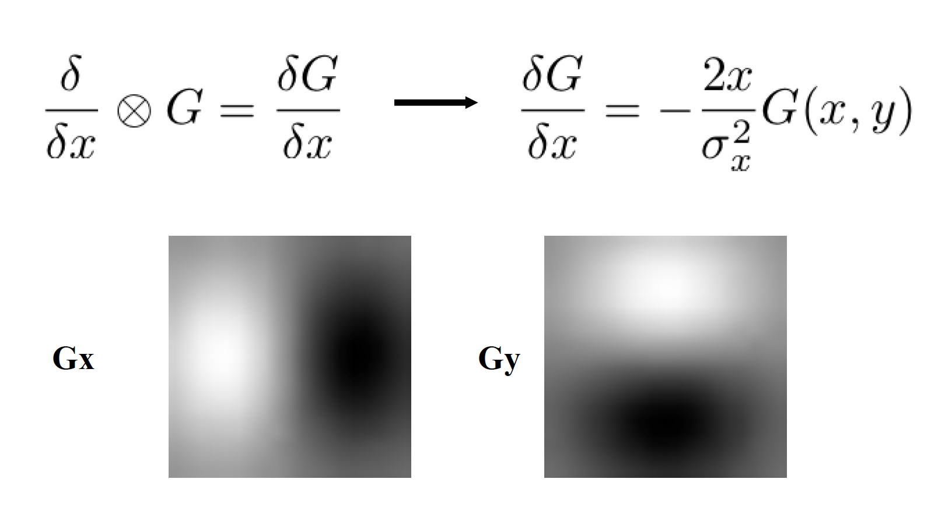
Smoothed derivative filter
Notes:
http://docs.scipy.org/doc/numpy/reference/generated/numpy.gradient.html

Slide 29
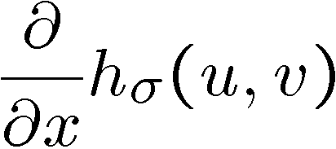
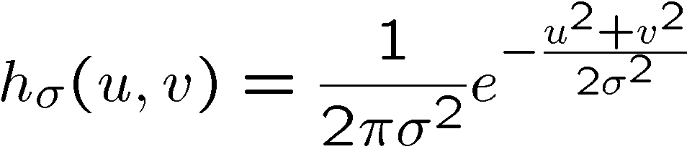
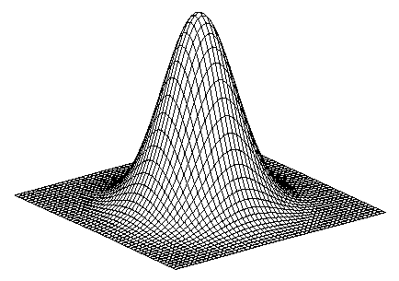
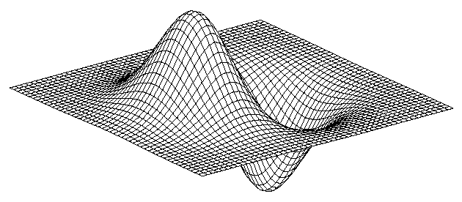
2D edge detection filters
derivative of Gaussian (x)
Gaussian
Notes:
How many 2nd derivative filters are there? There are four 2nd partial derivative filters.
In practice, it’s handy to define a single 2nd derivative filter—the Laplacian

Slide 30
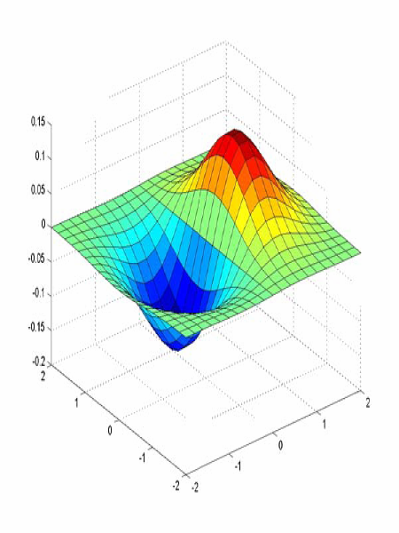
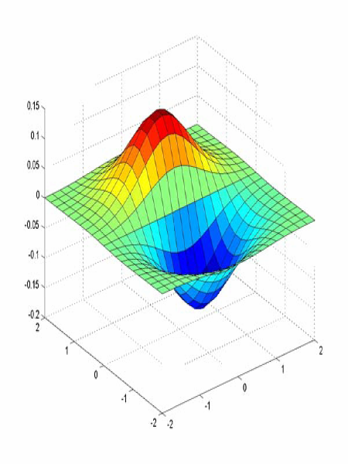
Derivative of Gaussian filter
x-direction
y-direction

Slide 31
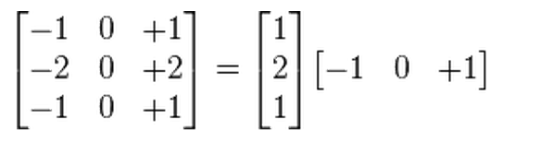
Sobel Filter
Product of averaging and gradient.
An cross product of two 1 d filter, Gaussian and gradient

Slide 32
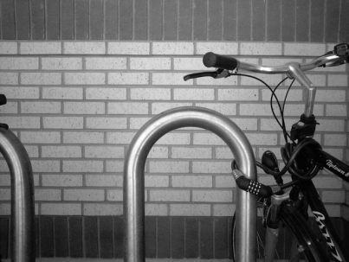
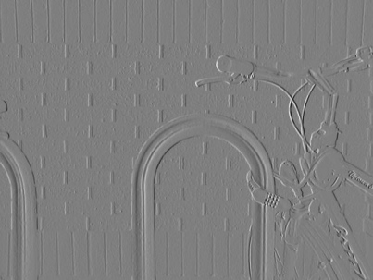
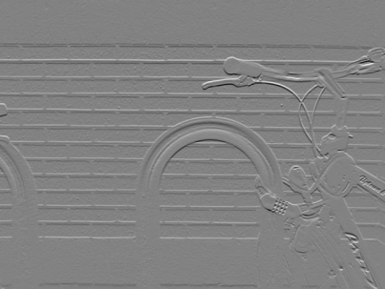





Sobel operator: example
Source: Wikipedia

Slide 33


Slide 34

Example
original image (Lena)

Slide 35

Finding edges
gradient magnitude

Slide 36


Finding edges
where is the edge?
thresholding

Slide 37
Next lecture
Image De-Noise
Think in frequency: Fourier space
Homework 3/Project 1 will be out later this week.
Office hour: Monday: 5:30-6:30, Thursday: 5-6:30.

Slide 38
Quiz 2
Write down a 3×3 filter that returns a positive value if the average value of the 4-adjacent neighbors is less than the center and a negative value otherwise. Hint: don’t forget the normalization factor.
Write down a filter that will compute the gradient in the x-direction
gradx(y,x) = im(y,x+1)-im(y,x) for each x,y

Slide 39

Quiz 2

